Slide 1

Human resources slide 1
Future of Artificial Intelligence:
Opportunities and Challenges
Roa Jaser - 202112142
Sama Sammar - 202110795
Yara Rabaia – 202110451
Mohammad Daraghmeh - 202112282

Slide 2
Human resources slide 2
Introduction
The world is witnessing a rapid technological revolution driven by artificial intelligence, which is no longer just a fantasy but has become an essential part of our reality. In this presentation, we explore the future of artificial intelligence, analyze the most prominent opportunities it offers, and the challenges this technology poses to societies and economies. Understanding this future is not a luxury, but a necessity to keep pace with change and contribute to shaping it in a responsible and sustainable manner.

Slide 3
Human resources slide 1
Literature Review
Studies have shown that artificial intelligence (AI) is a fundamental pillar of global digital transformation. According to a report by the McKinsey Institute, AI is expected to add more than $13 trillion to the global economy by 2030. Other research indicates that more than 70% of major companies have already begun adopting AI systems to improve efficiency and decision-making. However, some studies warn of the risks of algorithmic bias and job losses, requiring an ethical and legislative framework to keep pace with this development.

Slide 4
Human resources slide 10
AI Algorithms and Their Impact
A Core Element in the Future of Artificial Intelligence.
Understanding how algorithms shape opportunities and challenges in AI development.

Slide 5
Human resources slide 1
Understanding AI Algorithms
AI algorithms are step-by-step instructions that guide machines in learning, reasoning, and making decisions.
They mimic human cognitive functions by analyzing large datasets and identifying patterns.
Their strength lies in adaptability, scalability, and speed of computation.

Slide 6
Human resources slide 10
Why Are AI Algorithms Important?
They form the 'intelligence' behind AI systems.
Enable automation, data-driven insights, and real-time decision-making.
Used in critical areas: medicine, finance, transportation, education, and more.

Slide 7
Human resources slide 4
Types of AI Algorithms
Supervised Learning
Reinforcement Learning
Learns from labeled data (e.g., spam detection).
Learns by trial and error (e.g., game-playing AI).
Unsupervised Learning
Deep Learning
Identifies hidden patterns (e.g., customer segmentation).
Mimics human brain with neural networks (e.g., image recognition).

Slide 8
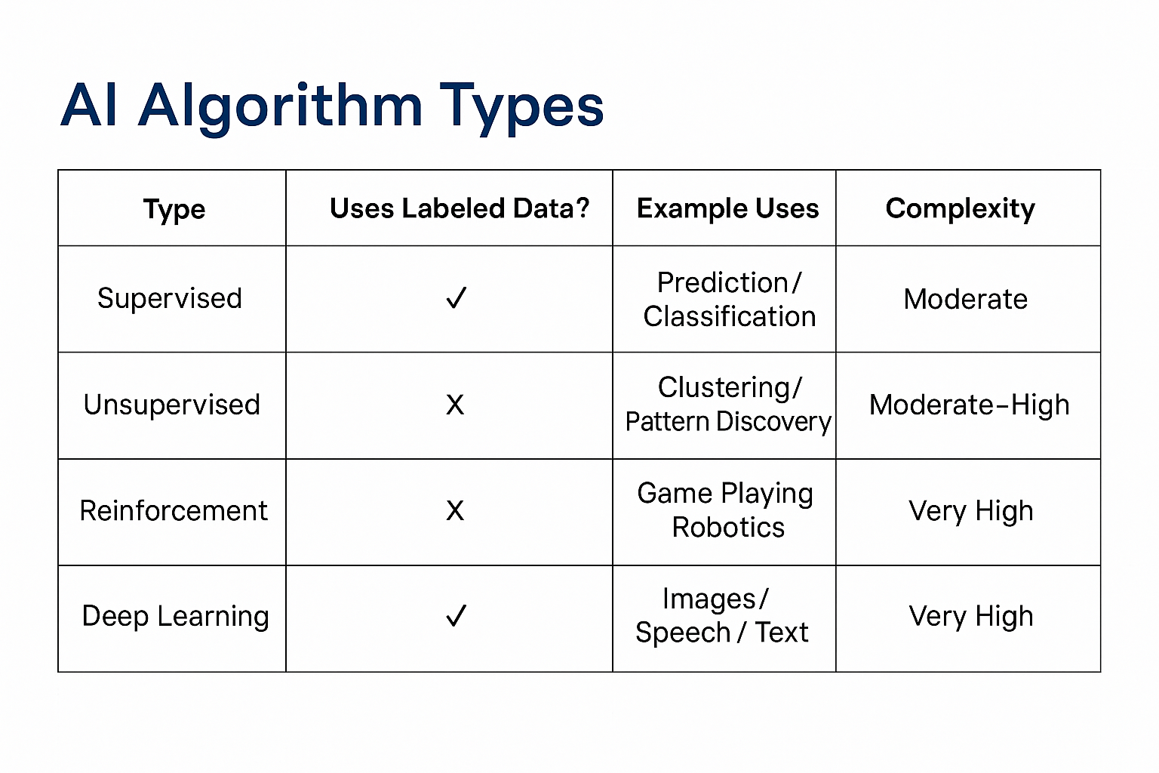
Human resources slide 1

Slide 9
Human resources slide 10
Real-Life Impact of AI Algorithms
Healthcare: Diagnose diseases from X-rays and medical scans.
Banking: Detect fraudulent activities in real time.
Transportation: Power autonomous vehicles.
Retail: Deliver personalized recommendations to customers.
Education: Support intelligent tutoring systems.

Slide 10
Human resources slide 1
Opportunities Enabled by AI Algorithms
Increased productivity and efficiency.
New business models and innovations.
Enhanced scientific research and data analysis.
Better services in healthcare, education, and urban planning.

Slide 11
Human resources slide 10
Challenges and Risks
Bias in algorithmic decisions.
Lack of transparency (black-box problem).
Job displacement due to automation.
Privacy concerns and misuse of data.

Slide 12
Human resources slide 1
Understanding AI Algorithms
AI algorithms are step-by-step instructions that guide machines in learning, reasoning, and making decisions.
They mimic human cognitive functions by analyzing large datasets and identifying patterns.
Their strength lies in adaptability, scalability, and speed of computation.

Slide 13
Human resources slide 10
Mitigation Strategies: Addressing the Risks
1. Fairness & Bias Audits – Ensure equitable algorithm outcomes.
2. Explainable AI – Make algorithm decisions understandable.
3. Data Governance – Protect user data and ensure ethical use.
4. Human-in-the-loop – Keep human oversight in critical decisions.
5. Regulation – Develop legal frameworks for responsible AI use.

Slide 14
Human resources slide 1
Vision for the Future
AI algorithms will continue to transform society.
Balance is needed: innovation must go hand in hand with ethical responsibility.
Global collaboration is essential to develop trustworthy, inclusive AI systems.

Slide 15
Human resources slide 10
Conclusion
AI algorithms are not just technical tools—they shape our economy, values, and daily life.
By understanding their power and limits, we can harness AI for a better, fairer future.

Slide 16





Human resources slide 1
Real-life Applications of AI
Voice Assistants: Help with reminders, searches, and controlling smart devices.
Social Media: Recommend content and filter harmful or fake posts.
Healthcare: Analyze medical images (X-rays, ECG) to detect diseases early.
Transportation: Self-driving cars like Tesla use AI to navigate and avoid accidents.
Entertainment: Netflix, Spotify, and YouTube use AI to suggest what you might like based on your behavior.

Slide 17
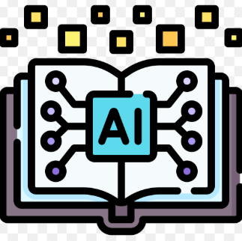


Human resources slide 10
Other Areas Where AI Is Used
Education: AI customizes learning based on each student's level and pace.
Finance: AI detects fraud and supports smart investment decisions.
Customer Service: AI chatbots provide fast, 24/7 support using natural language.

Slide 18
Human resources slide 1
Recommendations for the Future of AI
Create Clear Regulations: Governments should ensure AI is safe and ethical.
Avoid Bias in AI Systems: Developers must make algorithms fair and transparent.
Invest in Education: Teach AI and coding in schools and universities.
Use AI for Good: Focus on healthcare, environment, and public safety.
Keep Human Control: AI should support people, not replace them.

Slide 19
Human resources slide 10
Ethical and Social Considerations
Privacy and Data Security🔐
AI systems often collect and analyze personal data. There’s a risk of data leaks or being used without consent. People must be informed about how their data is collected and used.

Slide 20
Human resources slide 1
Fairness and Bias⚖️
AI can learn unfair patterns from biased training data. This can lead to discrimination in hiring, policing, loans, etc. It’s important to audit AI systems regularly to reduce bias.

Slide 21
Human resources slide 10
Job Displacement and Inequality🤖
Automation may replace low-skill or repetitive jobs. This can increase income gaps between people with different skills.
Society must support retraining and new job opportunities.

Slide 22
Human resources slide 10
Social Impact and Trust🌍
AI changes how we interact with each other and with machines. If people don’t trust AI, they may not accept its use. Building public trust is essential.

Slide 23
Human resources slide 1
Expected Results
AI will grow in health, schools, business, and cities.
•New jobs will appear. Some jobs may disappear.
• New laws will protect people from AI risks.
• We need training to work well with AI.
• Together, we can make AI a positive part of the future.

Slide 24
Human resources slide 10
Conclusion
Artificial Intelligence is a powerful and smart tool.
It has the potential to improve healthcare, education, business, and daily life. However, AI must be used with care and proper planning. We must design AI systems that are fair, transparent, and safe for everyone. Clear rules and ethical guidelines are needed to guide its development. Public awareness and education about AI are very important. The future of AI will depend on how we choose to use and control it today.

Slide 25
Human resources slide 10
Thank You

